Slide 1

WIWINO Data analysis

Slide 2
INTRODUCTION
Overview:
Analyzing the Wiwino dataset to extract insights and address specific inquiries.
Goals:
Answering key questions, identifying patterns, and deriving actionable conclusions.
Methodology:
Exploratory data analysis

Slide 3


Overview
Which wines to choose and why to increase sales
10 wines to increase sales
Which country do we prioritize and why
Limited marketing budget
3 relevant categories to award the best wineries
Winery awards

Slide 4
Overview
Find all wines with at least 10 users that include specific tasting notes
Specific taste combination
Identify the top 3 most popular grapes and their 5 best reviewed wines
Top wines for common grapes
Show average wine rating for each country
Country leaderboard
Top 5 recommendations for VIP client
Cabernet sauvignon

Slide 5
AGENDA
01.
02.
03.
04.
05.
06.
10 wines to increase sales
Limited marketing budget
Winery awards
Which wines to choose and why to increase sales
Which country do we prioritize and why
3 relevant categories to award the best wineries
Specific taste combination
Our team
Conclusions
You can describe the topic of the section here
You can describe the topic of the section here
You can describe the topic of the section here

Slide 6
10 wines to increase sales
Approach
Create ratio of rating over price.
Highest ratio ➔ best value wine
SELECT vintages.name, wines.is_natural, vintages.ratings_average, vintages.ratings_count, ROUND(price_per_rating,2) AS rating_per_price, price_euros, bottle_volume_ml FROM wines JOIN vintages ON wines.id = vintages.wine_id WHERE vintages.ratings_count > 0 AND vintages.ratings_average > 0 ORDER BY price_per_rating DESC LIMIT 10;

Slide 7

 | Average rating | Number of reviews | Rating per price | Price (€) | Volume
Château Voigny Sauternes 2019 | 4.4 | 143 | 31.54 | 13.95 | 375
Cignomoro Primitivo di Manduria 2021 | 4.5 | 32 | 24 | 18.75 | 750
Luccarelli Old Vines Primitivo di Manduria 2019 | 4.4 | 274 | 21 | 20.95 | 750
Puglia Pop Triglia Negroamaro Rosato 2022 | 4.7 | 25 | 20.48 | 22.95 | 750
Vigneti del Salento Vigne Vecchie Gold Series Leggenda Primitivo di Manduria 2019 | 4.5 | 424 | 18.79 | 23.95 | 750
Farnese Cinque Autoctoni Collection Limited Release 2020 | 4.4 | 255 | 18.41 | 23.9 | 750
Puglia Pop Luminaria Primitivo di Manduria 2021 | 4.5 | 71 | 18.04 | 24.95 | 750
Rutini Malbec 2019 | 4.4 | 2567 | 16.93 | 25.99 | 750
Guerrieri Guerriero della Terra 2019 | 4.4 | 1803 | 16.51 | 27.4 | 750
Guerrieri Guerriero della Terra 2020 | 4.4 | 182 | 16.51 | 25.95 | 750

Slide 8
Limited marketing budget
Approach
Create ratio of wineries over users.
Highest ration ➔ most wine variability per user ➔ more opportunities to use WIWINO
UPDATE countries SET wineries_user_ratio = ROUND(CAST(wineries_count AS float) / CAST(users_count AS float) * 100,2) WHERE users_count > 0; ​ SELECT * FROM countries ORDER BY wineries_user_ratio DESC LIMIT 5;

Slide 9
 | Regions | Users | Wines | Wineries | Wineries users ration
Moldova | 9 | 13583 | 5055 | 418 | 3.08
Hungary | 29 | 102235 | 16605 | 1923 | 1.88
Chile | 41 | 326757 | 41191 | 5785 | 1.77
South Africa | 112 | 269649 | 30857 | 4227 | 1.57
Croatia | 22 | 64223 | 5880 | 980 | 1.53
Focusing marketing efforts on countries with high wineries to user ratios is advantageous:
Indicates strong demand for wine relative to available wineries.
Moldova:
Wineries to user ratio: 3.08.
Prime market for marketing efforts.
High ratio suggests potentially underserved market with room for growth.
Promising countries:
Hungary, Chile, South Africa, Croatia.
Exhibit high wineries to user ratios.
Signify significant potential for market penetration and customer engagement in wine industries.

Slide 10
Winery award
Approach
Identify 3 categories for awards
Best wine by average rating
Best natural wine by average rating
Best wine under 50 euros
SELECT name, winery_id, ratings_average, ratings_count FROM wines ORDER BY ratings_average DESC, ratings_count DESC LIMIT 3;
SELECT name, winery_id, ratings_average, ratings_count, is_natural FROM wines WHERE is_natural IS TRUE ORDER BY ratings_average DESC, ratings_count DESC ​LIMIT 3;
SELECT wines.name, winery_id, wines.ratings_average, wines.ratings_count, vintages.price_euros FROM wines JOIN vintages ON wines.id = vintages.wine_id WHERE vintages.price_euros < 50 ORDER BY wines.ratings_average DESC, wines.ratings_count DESC LIMIT 3;

Slide 11
best wine overall | Winery ID* | Average rating | Number of reviews
Cabernet Sauvignon | 14919 | 4.8 | 2941
Amarone della Valpolicella Classico Riserva | 11601 | 4.8 | 587
Fratini Bolgheri Superiore | 277785 | 4.8 | 153
best natural wine | Winery ID* | Average rating | Number of reviews
Bassolino di Sopra Brunello di Montalcino | 5567 | 4.6 | 174
Les Poyeux Saumur Champigny | 2283 | 4.5 | 2005
Le Bourg Saumur Champigny | 2283 | 4.5 | 1264
best budget wine | Winery ID* | Average rating | Number of reviews | Price (€)
60 Sessantanni Old Vines Primitivo di Manduria | 55648 | 4.5 | 94289 | 24.75
Limited Edition 10 Vendemmie | 17793 | 4.5 | 9453 | 34.2
Lupi Rezerva | 27224 | 4.5 | 7604 | 36.55
*Due to data issues it was not possible to derive the winery name from the winery ID

Slide 12
Specific taste combination
Approach
Identify flavor IDs
Identify wines with at least 10 mentions for each flavor
SELECT wines.name AS wine_name, keywords_wine.*, keywords.name AS keyword_name FROM wines JOIN keywords_wine ON wines.id = keywords_wine.wine_id JOIN keywords ON keywords_wine.keyword_id = keywords.id WHERE keywords.name IN ('coffee', 'toast', 'green apple', 'cream', 'citrus') AND keywords_wine.count >= 10 GROUP BY wine_name HAVING COUNT(DISTINCT keyword_name) = 5;

Slide 13
Wine Name | Group Name | Flavor count
Belle Epoque Brut Champagne | tree_fruit | 224
Blanc des Millénaires | non_oak | 160
Brut Champagne | non_oak | 2165
Comtes de Champagne Blanc de Blancs | non_oak | 587
Cristal Brut Champagne (Millésimé) | non_oak | 464
Cuvée des Enchanteleurs Brut Champagne | non_oak | 31
Dom Ruinart Blanc de Blancs Brut Champagne | non_oak | 226
Grande Cuvée | non_oak | 713
La Grande Année Brut Champagne | non_oak | 525
La Grande Dame Brut Champagne | non_oak | 244
Le Mesnil Blanc de Blancs (Cuvée S) Brut Champagne | citrus_fruit | 240
MV | oak | 10
P2 Plénitude Brut Champagne | non_oak | 161
R.D Extra Brut Champagne (Récemment Dégorgé) | non_oak | 163
Sauternes | tree_fruit | 13
Sauternes (Premier Grand Cru Classé) | tree_fruit | 10
Sir Winston Churchill Brut Champagne | non_oak | 282
Trebbiano d'Abruzzo | oak | 21
Vintage | non_oak | 356

Slide 14
Top wines for popular grapes
Approach
Find 3 most common grapes
Grape name | Count
Cabernet Sauvignon | 9621012
Merlot | 6233909
Chardonnay | 3625248
SELECT grapes.name, SUM(wines_count) AS total_wines_count FROM most_used_grapes_per_country JOIN grapes ON most_used_grapes_per_country.grape_id = grapes.id GROUP BY grapes.name ORDER BY total_wines_count DESC LIMIT 3;

Slide 15
Top wines for popular grapes
Approach
2. Find 5 highest rated wines for Cabernet Sauvignon, Chardonnay and Merlot
SELECT grape_name, wine_name, wine_rating, ratings_count, price_euros FROM ( SELECT grapes.name AS grape_name, wines.name AS wine_name, wines.ratings_average AS wine_rating, wines.ratings_count, vintages.price_euros, ROW_NUMBER() OVER (PARTITION BY grapes.name ORDER BY wines.ratings_average DESC) AS rank FROM wines INNER JOIN regions ON wines.region_id = regions.id INNER JOIN vintages ON wines.id = vintages.wine_id INNER JOIN countries ON regions.country_code = countries.code INNER JOIN most_used_grapes_per_country ON countries.code = most_used_grapes_per_country.country_code INNER JOIN grapes ON most_used_grapes_per_country.grape_id = grapes.id WHERE grapes.name IN ('Merlot', 'Chardonnay', 'Cabernet Sauvignon') ) AS ranked_wines WHERE rank <= 5 ORDER BY grape_name, wine_rating DESC;

Slide 16
 | Wine name | Rating | Number of reviews | Price (€)
Cabernet Sauvignon | Cabernet Sauvignon | 4.8 | 2941 | 1558.75
Cabernet Sauvignon | Mágico | 4.8 | 146 | 480
Cabernet Sauvignon | Special Selection Cabernet Sauvignon | 4.7 | 41236 | 397.5
Cabernet Sauvignon | Harlan Estate Red | 4.7 | 7231 | 1921.25
Cabernet Sauvignon | Unico | 4.7 | 45140 | 410
Chardonnay | Amarone della Valpolicella Classico Riserva | 4.8 | 587 | 1046.25
Chardonnay | Cabernet Sauvignon | 4.8 | 2941 | 1558.75
Chardonnay | Fratini Bolgheri Superiore | 4.8 | 153 | 262.6
Chardonnay | Cristal Rosé Vinothèque | 4.8 | 88 | 1600
Chardonnay | Batard-Montrachet Grand Cru | 4.8 | 34 | 1149.5
Merlot | Amarone della Valpolicella Classico Riserva | 4.8 | 587 | 1046.25
Merlot | Fratini Bolgheri Superiore | 4.8 | 153 | 262.6
Merlot | Cristal Rosé Vinothèque | 4.8 | 88 | 1600
Merlot | Batard-Montrachet Grand Cru | 4.8 | 34 | 1149.5
Merlot | Clos du Mesnil | 4.7 | 2471 | 5017.5

Slide 17
Country leaderboard
Approach
Select all countries in dataset
Display average rating per country
CREATE TABLE wine_ratings AS SELECT countries.name, ROUND(AVG(wines.ratings_average),2) AS average_rating FROM wines INNER JOIN regions ON wines.region_id = regions.id INNER JOIN countries ON regions.country_code = countries.code GROUP BY countries.name;

Slide 18
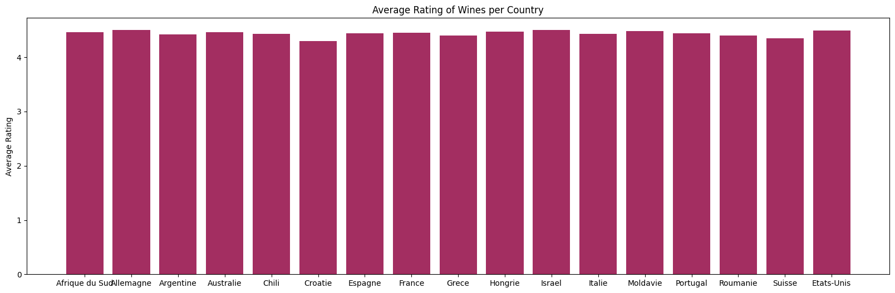
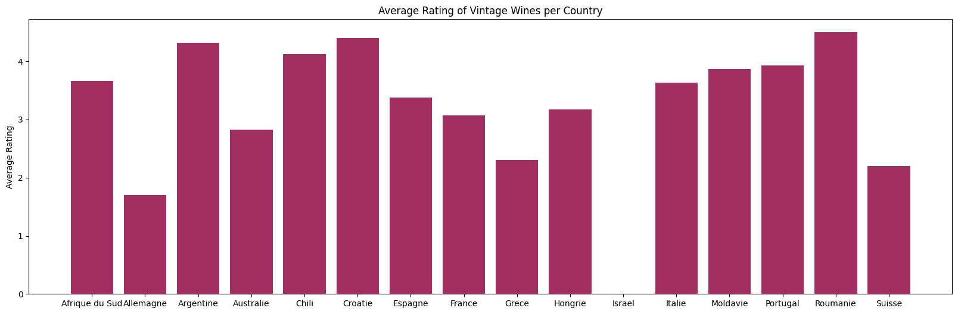

Slide 19
Cabernet Sauvignon for VIP
Approach
SELECT grapes.name AS grape_name, wines.name AS wine_name, wines.ratings_average AS wine_rating, wines.ratings_count, vintages.price_euros,vintages.bottle_volume_ml, vintages.year, wines.is_natural FROM wines INNER JOIN regions ON wines.region_id = regions.id INNER JOIN vintages ON wines.id = vintages.wine_id INNER JOIN countries ON regions.country_code = countries.code INNER JOIN most_used_grapes_per_country ON countries.code = most_used_grapes_per_country.country_code INNER JOIN grapes ON most_used_grapes_per_country.grape_id = grapes.id WHERE grapes.name = 'Cabernet Sauvignon' ORDER BY wine_rating DESC LIMIT 5;
Select all Cabernet Sauvignon wines
Order by rating
Repeat for subcategories
Natural wines
Bottle size
price

Slide 20
Overall best Cabernet Sauvignon wine | Rating | Number of reviews | Price (€) | Year
Cabernet Sauvignon | 4.8 | 2941 | 1558.75 | 2015
Mágico | 4.8 | 146 | 480 | 2019
Special Selection Cabernet Sauvignon | 4.7 | 41236 | 397.5 | 1997
Harlan Estate Red | 4.7 | 7231 | 1921.25 | 1998
Unico | 4.7 | 45140 | 410 | 2012
Best natural Cabernet Sauvignon wine | Rating | Number of reviews | Price (€) | Year
Camí Pesseroles | 4.5 | 1083 | 84.95 | 2019
Les Manyes | 4.4 | 924 | 215.44 | 2018
Best magnum size Cabernet Sauvignon wine | Rating | Number of reviews | Price (€) | Year
Special Selection Cabernet Sauvignon | 4.7 | 41236 | 443 | 2017
Continuum Estate | 4.6 | 6949 | 645 | 2013

Slide 21
Best Cabernet Sauvignon wine < €200 | Rating | Number of reviews | Price (€) | Year
Don PX Convento Selección | 4.7 | 1224 | 198.4 | 1955
La Vina de Corteo | 4.7 | 374 | 99.95 | 2019
Alabaster | 4.6 | 2708 | 136.25 | 2007
Tokaji Aszú 6 Puttonyos | 4.6 | 2366 | 99.97 | 2013
Finca Garbet | 4.6 | 573 | 168 | 2015
Best Cabernet Sauvignon wine < €50 | Rating | Number of reviews | Price (€) | Year
Ice Wine de Purcari | 4.5 | 722 | 33.17 | 2017
Lupi Rezerva | 4.5 | 7604 | 36.55 | 2017
Negru de Purcari Limited Edition | 4.5 | 970 | 33.17 | 2019
Kalós Cru Gran Reserva Malbec | 4.5 | 3351 | 34.85 | 2018
Yarden Katzrin | 4.5 | 894 | 37.05 | 2021

Slide 22


Questions?

